Slide 1
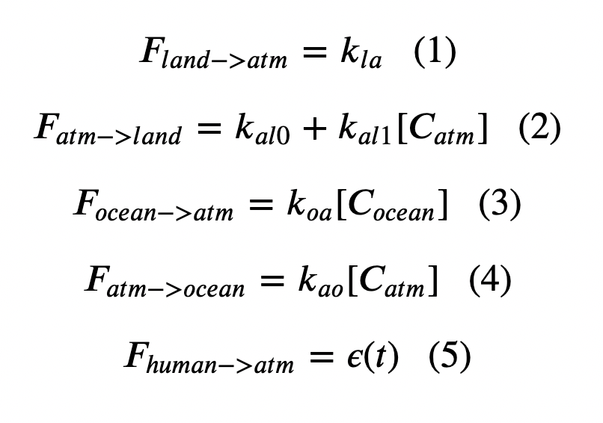
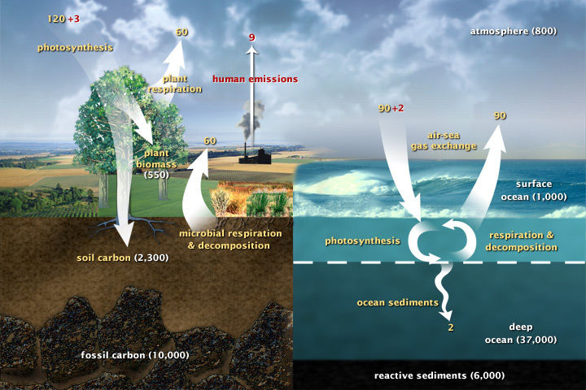
Cambio 1.0 Equations (This is a recap of what we introduced at the end of Week 3)

Slide 2
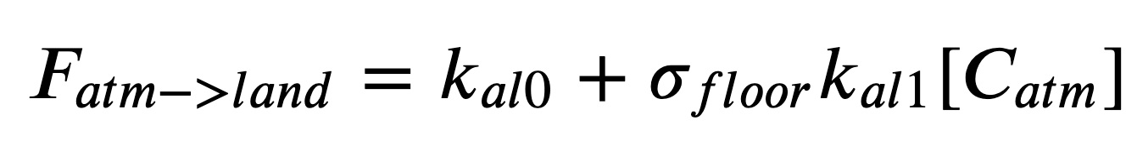

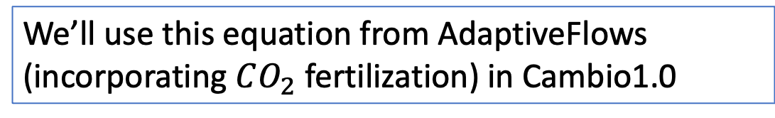
Cambio 1.0 Equations
We’ll use this equation from AdaptiveFlows (incorporating $CO_{2}$ fertilization) in Cambio1.0
We’ll add in the $σ_{floor}$ term (temperature feedback) in Cambio2.0

Slide 3
Cambio 1.0 Equations
The more concentrated the $CO_{2}$ is in the water, the faster it will come out!

Slide 4
Cambio 1.0 Equations
The more concentrated the $CO_{2}$ is in the air, the faster it will go into the ocean!

Slide 5
Cambio 1.0 Equations
You’ll be uploading emission scenario files you generated in ScheduledFlows

Slide 6
Cambio 1.0 Equations
Inside the Euler loop (math):

Slide 7
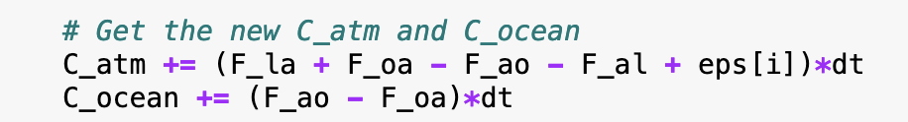
Cambio 1.0 Equations
Inside the Euler loop (Python):

Slide 8
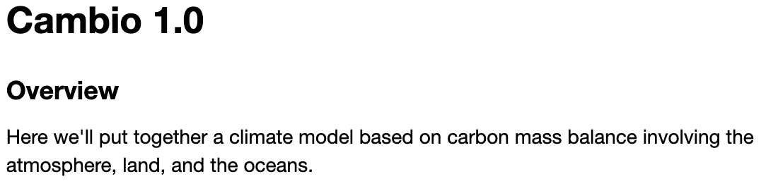
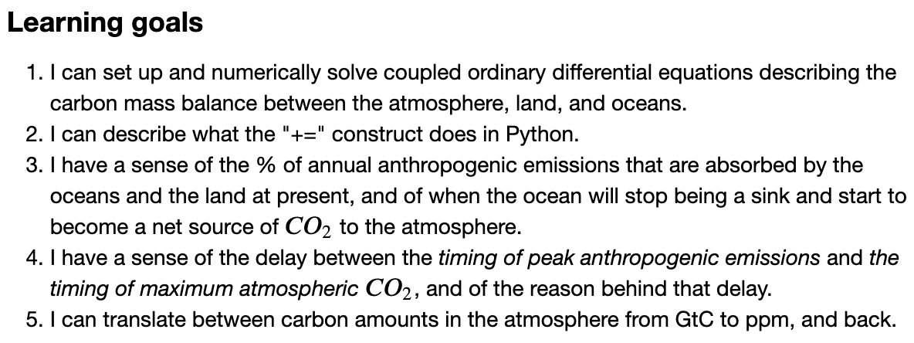
OK, let’s get started!

